Slide 1

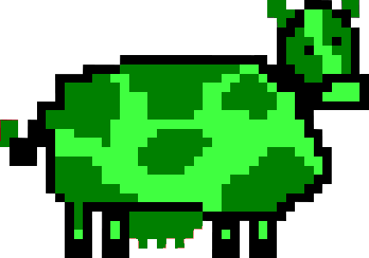
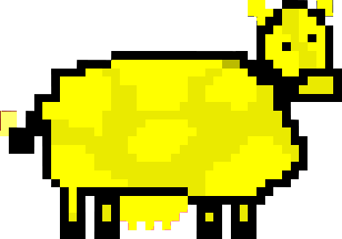
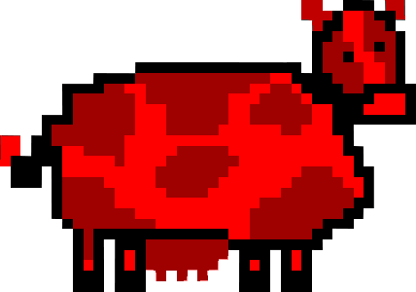
Cow Panic! – Group 6301
Key achievements in the last week
Completed background art Began implementation of cow variations Fixed bugs related to cows spawning on-screen and UFO not moving to edges of screen Added lives and score displays to HUD in-game
Plan to keep/get project to Green status
Keep up with the Gantt Chart schedule Plan to meet outside of class time to finish developing the game
Key planned activities for the next week
Implement background art and add moosic & sounds to the game Add font to initials-input and score display Test lives-tracking and score-saving Add lives and score displays in-game Add the main menu Complete implementation of cow variations Create an options screen Write system manual and user manual Fix camera size and settings for every scene
Key risks / issues / scope changes
Possibility that SourceTree will rise from the grave and casting darkness over the land (again), exhuming many bugs that had long ago been buried Difficulty meeting outside of class to finish the project
5/25/16
Legend: Yippee!!! Meh… DEFCON 1!!!

Slide 2
Project Name and Team Number
Key achievements in the last week
[Detail the key achievements in the last period]
Plan to keep/get project to Green status
[Detail the key achievements in the last period]
Key planned activities for the next week
[Detail the key planned activities for the next period]
Key risks / issues / scope changes
[Detail key risks and issues]
Date
Legend: Yippee!!! Meh… DEFCON 1!!!

